Slide 1
Unpack your bookbag.
Use the restroom.
Sharpen your pencils.
Start your morning work.

Slide 2
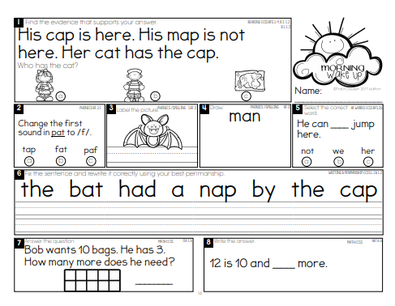
Let's check our Morning Work. Correct your paper.

Slide 3
Sight Words Review

Slide 4
List 5

Slide 5
her

Slide 6
fly

Slide 7
said

Slide 8
round

Slide 9
his

Slide 10
Run fast.

Slide 11
I want it.

Slide 12
We made it.

Slide 13
Go to sleep.

Slide 14
Spelling Words

Slide 15
scan

Slide 16
scat

Slide 17
skip

Slide 18
skid

Slide 19
stop

Slide 20
spot

Slide 21
snap

Slide 22
sniff

Slide 23
swell

Slide 24
swim

Slide 26
The students know how to read these.

Slide 41
the
a
and

Slide 42
Dad sat on the log.
Tom had a dog.

Slide 45
Ted
had
a
cat
and
a
dog
.
Meg
had
the
red
hat
.
Notes:
IN PRESENTATION MODE:
Have students read the sentence

Slide 46
Cut letters apart. Use to make words in the –it family. Practice reading them at home.

Slide 47
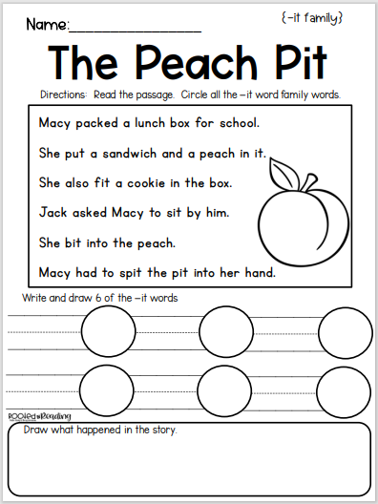

Slide 48
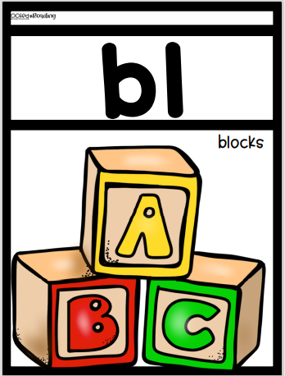
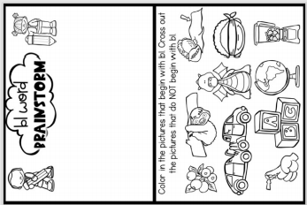

Slide 50
Let's Discuss the Story

Slide 51
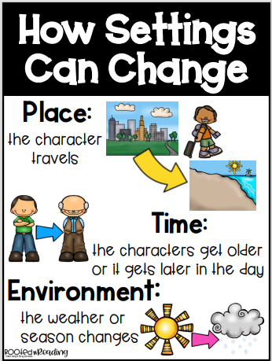

Slide 52
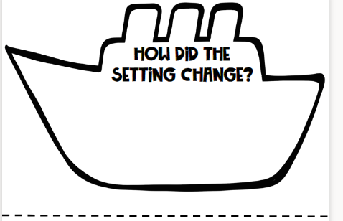
The main character traveled all over the world to get the ingredients for the apple pie.

Slide 53
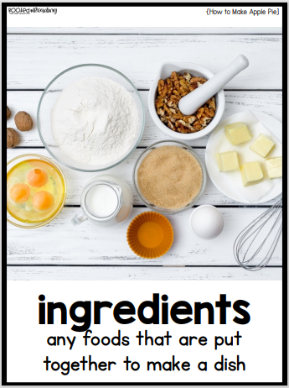
What Ingredients would you need to make apple pie?

Slide 54
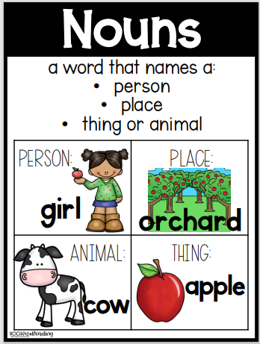
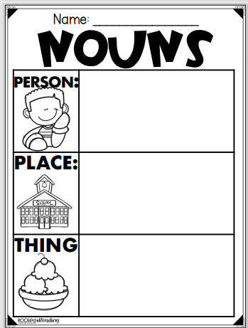
Fill in examples for each.

Slide 55
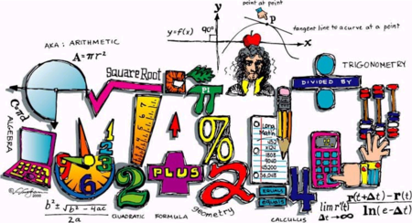

Slide 56
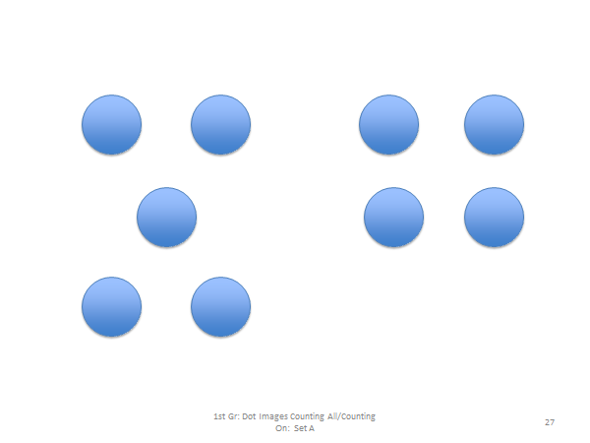

Slide 59
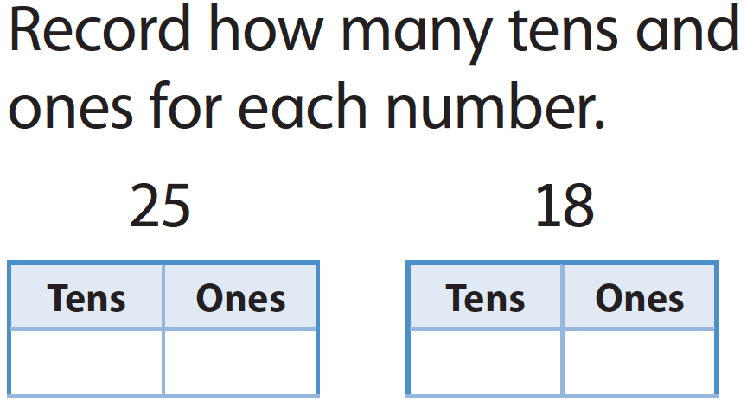

Slide 62
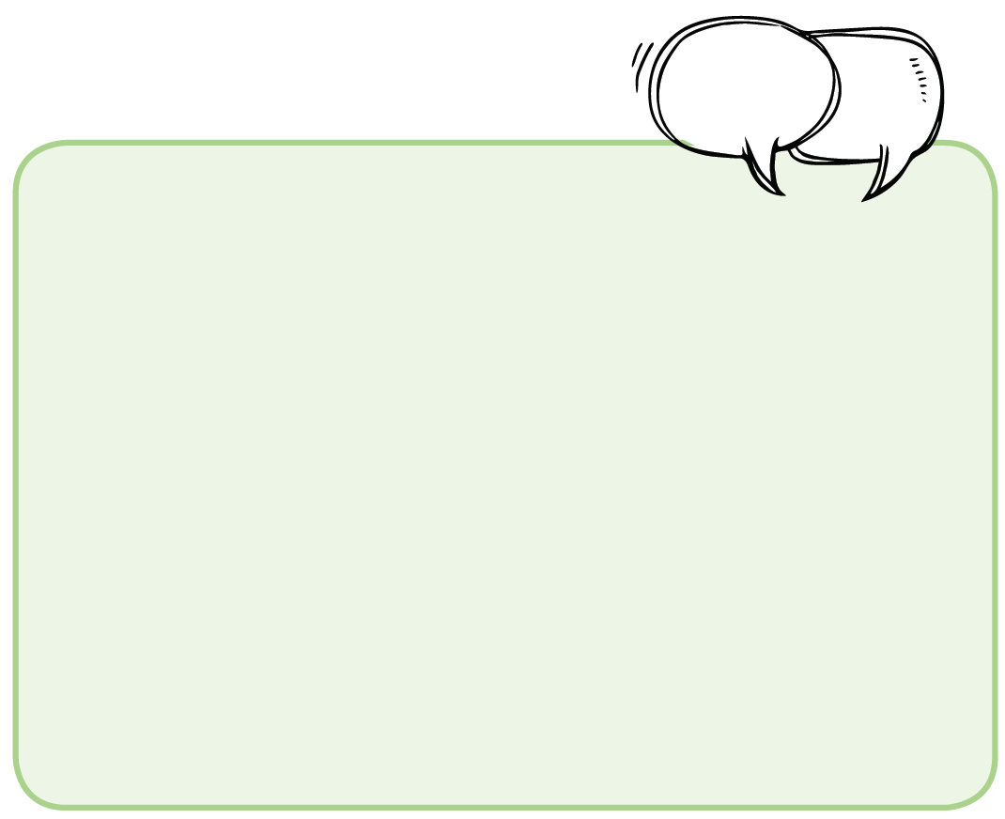
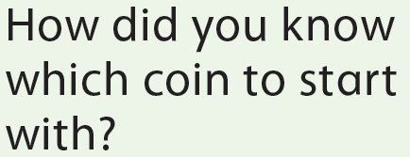

Slide 64
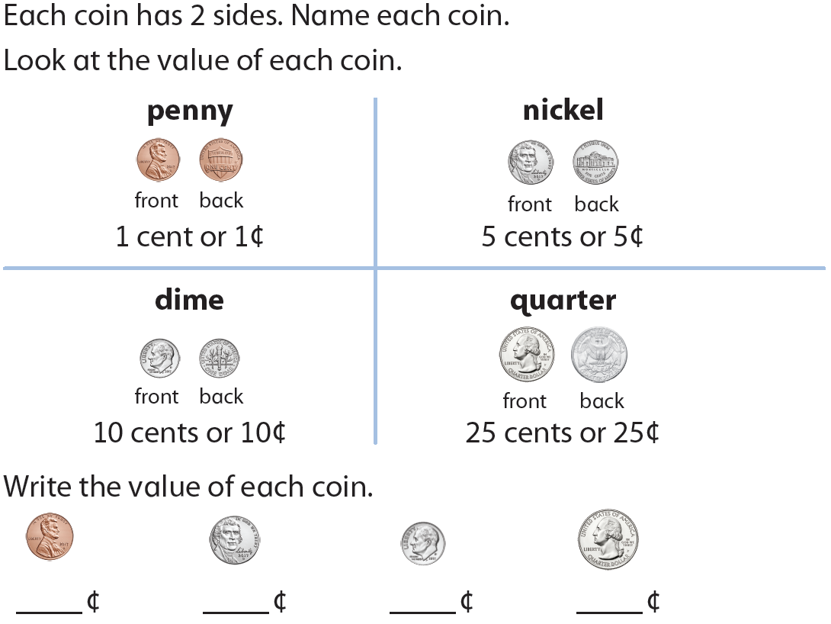

Slide 73
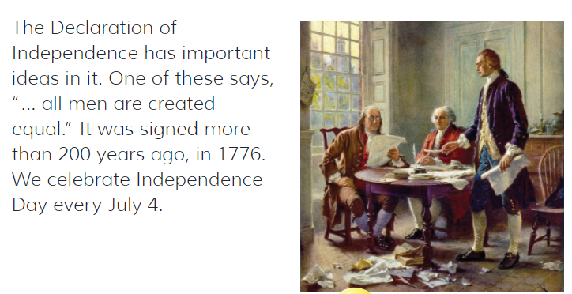

Slide 74
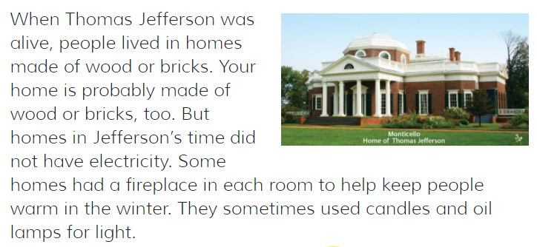

Slide 75
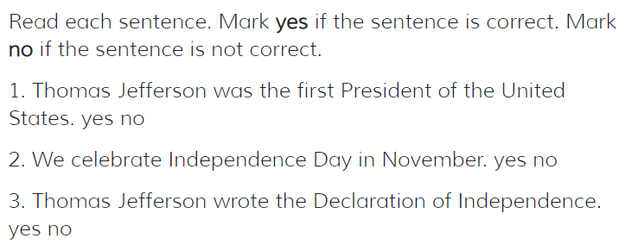

Slide 77
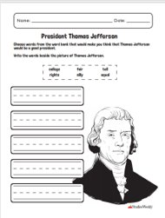
Draw a picture of Thomas Jefferson's house on the "then" side. Draw a picture of your house on the "Now" side.

